Slide 1
CISC 5352 Financial Data Analytics Final project
Laiba Shah
Wanjia Song
Zihan Li
Ziyuan Zhou

Slide 2
Part B
Endowment Analytics
This part includes:
Visualization of relationship between endowment and other factors.
PCA analysis
Twitter analysis
Machine learning and selective learning
Learning validation

Slide 3
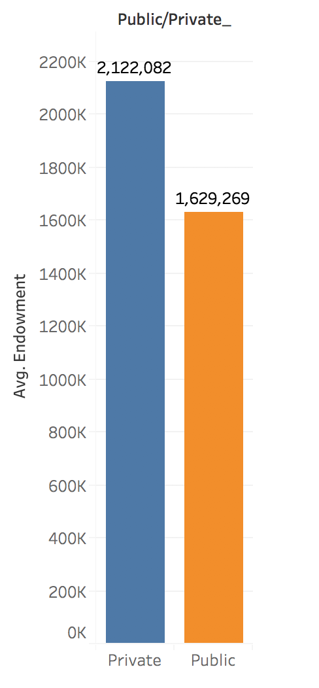
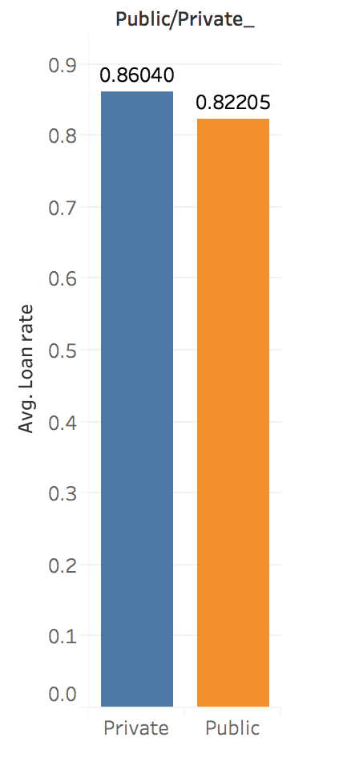
Visualizations - Endowments and Loan Rate Analysis
Private schools tend to receive more endowments than public schools.
Private schools also have higher loan rates for students.

Slide 4
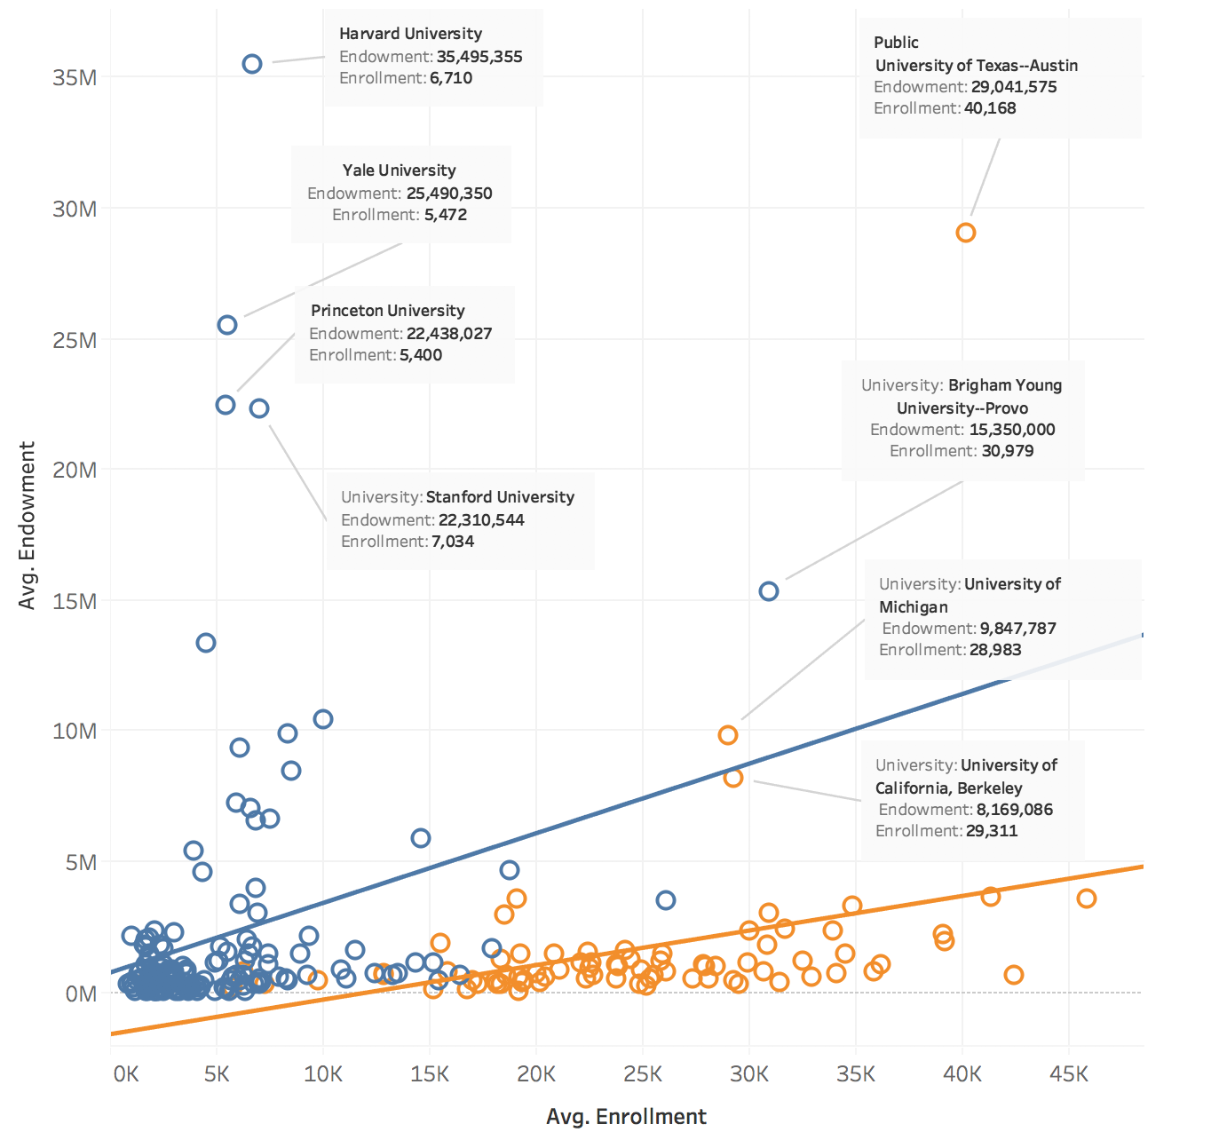
Visualizations - Endowments vs Enrollments
Leading universities appear to be outliners --- Remove them first

Slide 5
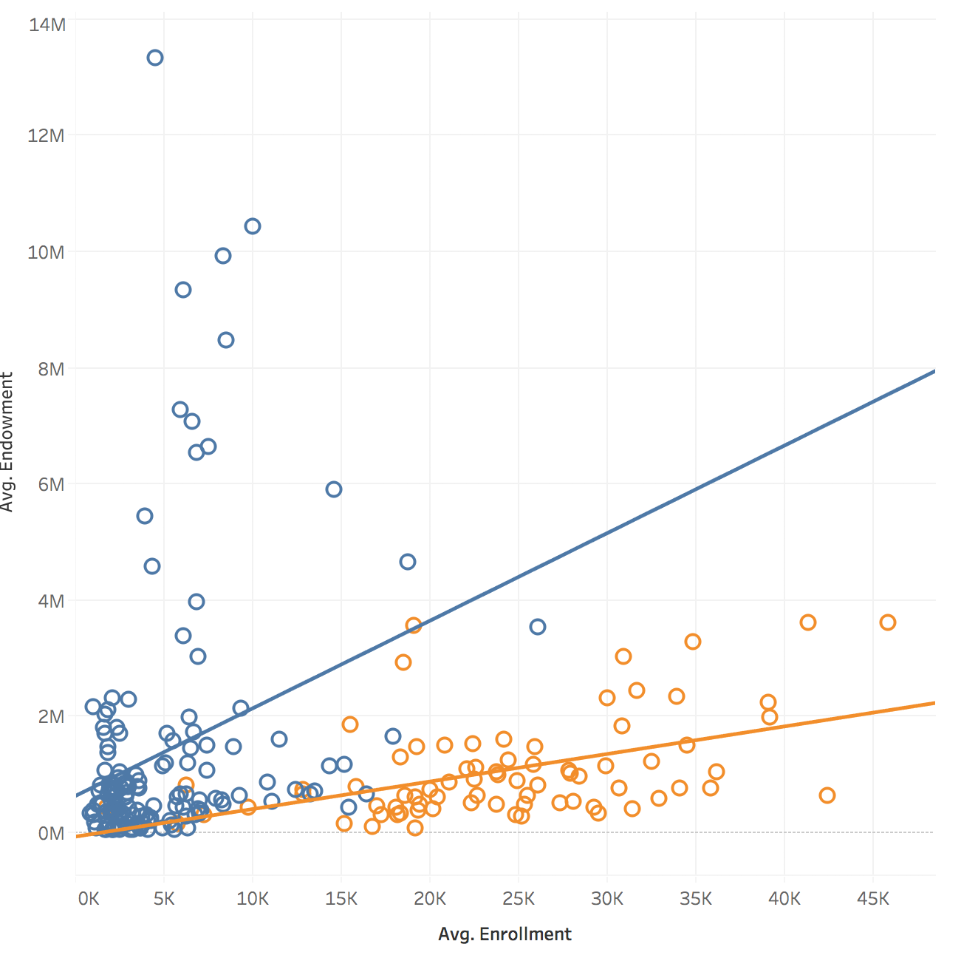
Visualizations - Endowments vs Enrollments
The graph does not reveal a very strong correlation between endowment and enrollment
Public schools have more enrollments but endowments they receive are in the same range of private schools

Slide 6
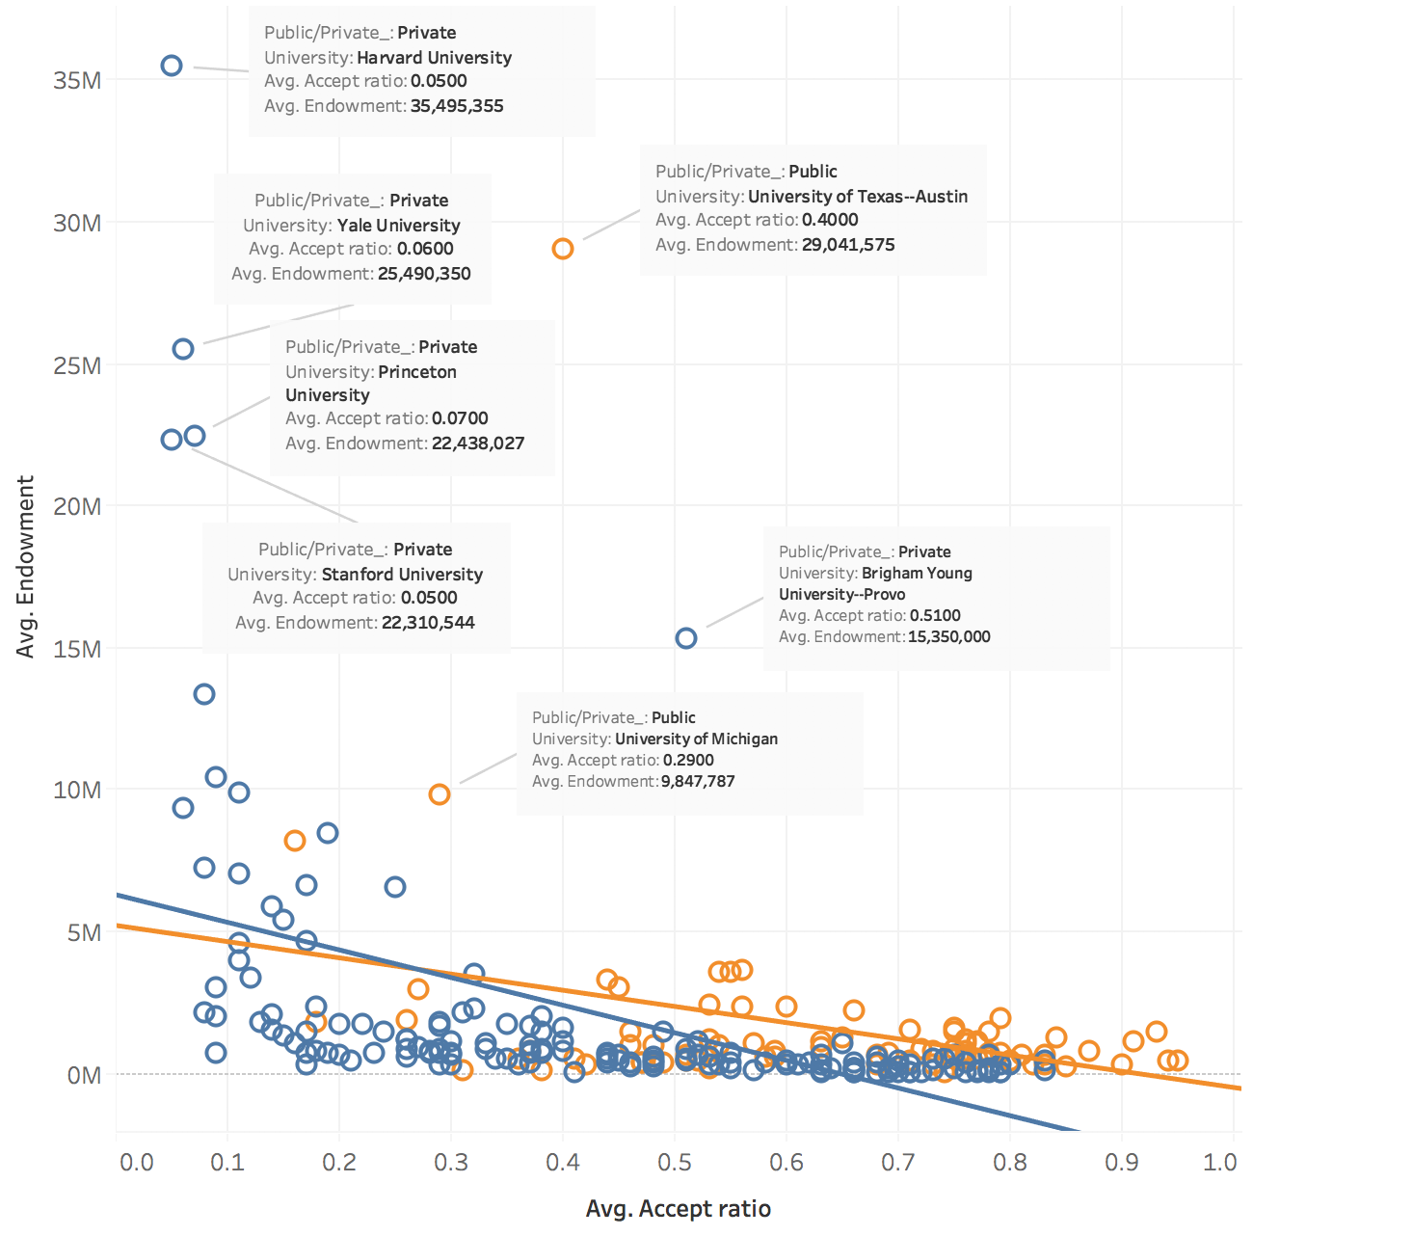
Visualizations - Endowments vs Acceptance ratio
Leading universities appear to be outliners --- Remove them first

Slide 7
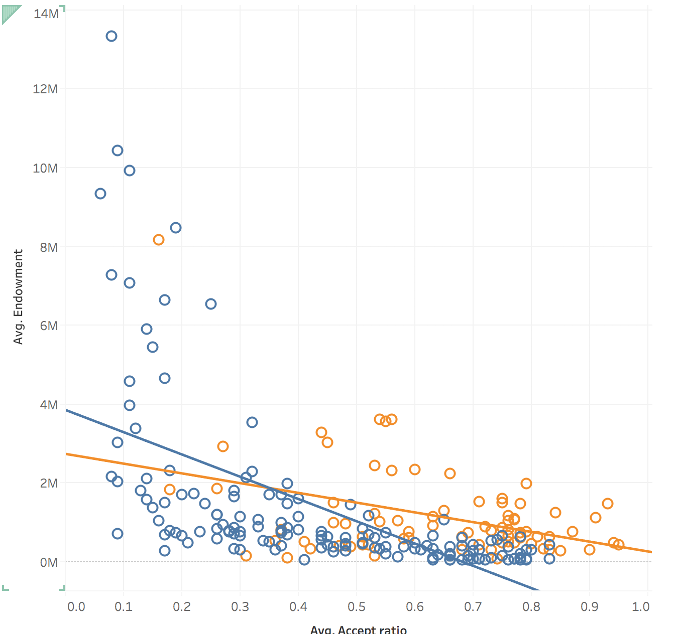
Visualizations - Endowments vs Acceptance ratio
The graph does not reveal a very strong correlation between endowment and acceptance ratio
Private schools have lower acceptance ratios but this fact does not affect endowments they receive every year

Slide 8
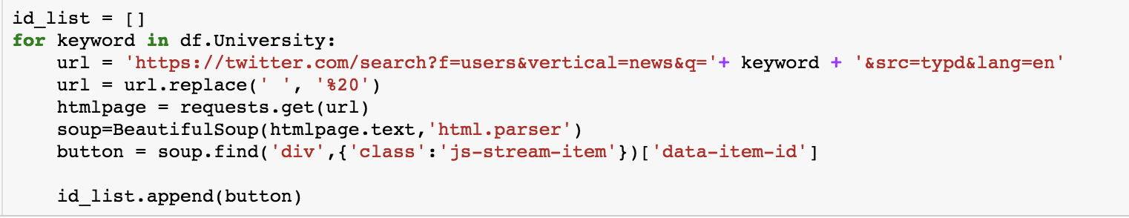
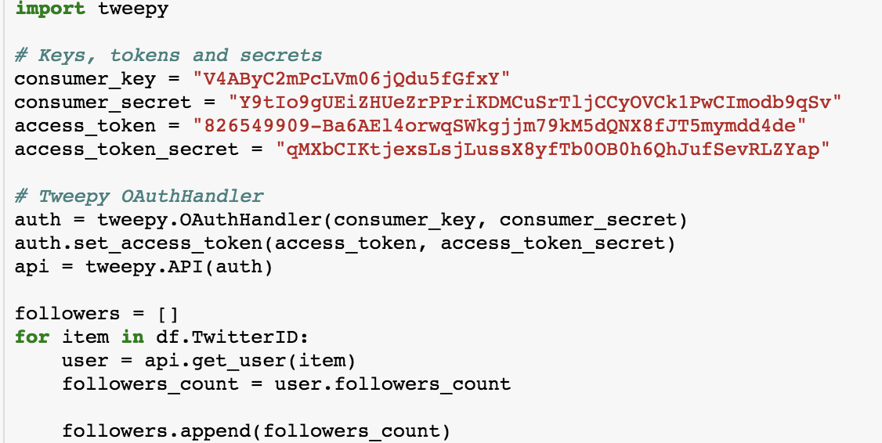
Twitter analytics - with twitter API

Slide 9
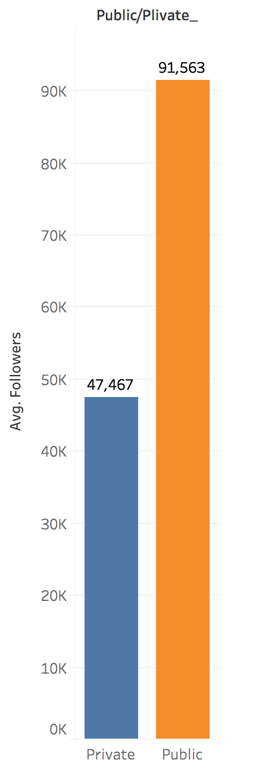
Visualizations - Twitter Followers Analysis
Public Schools have more Twitter Followers

Slide 10
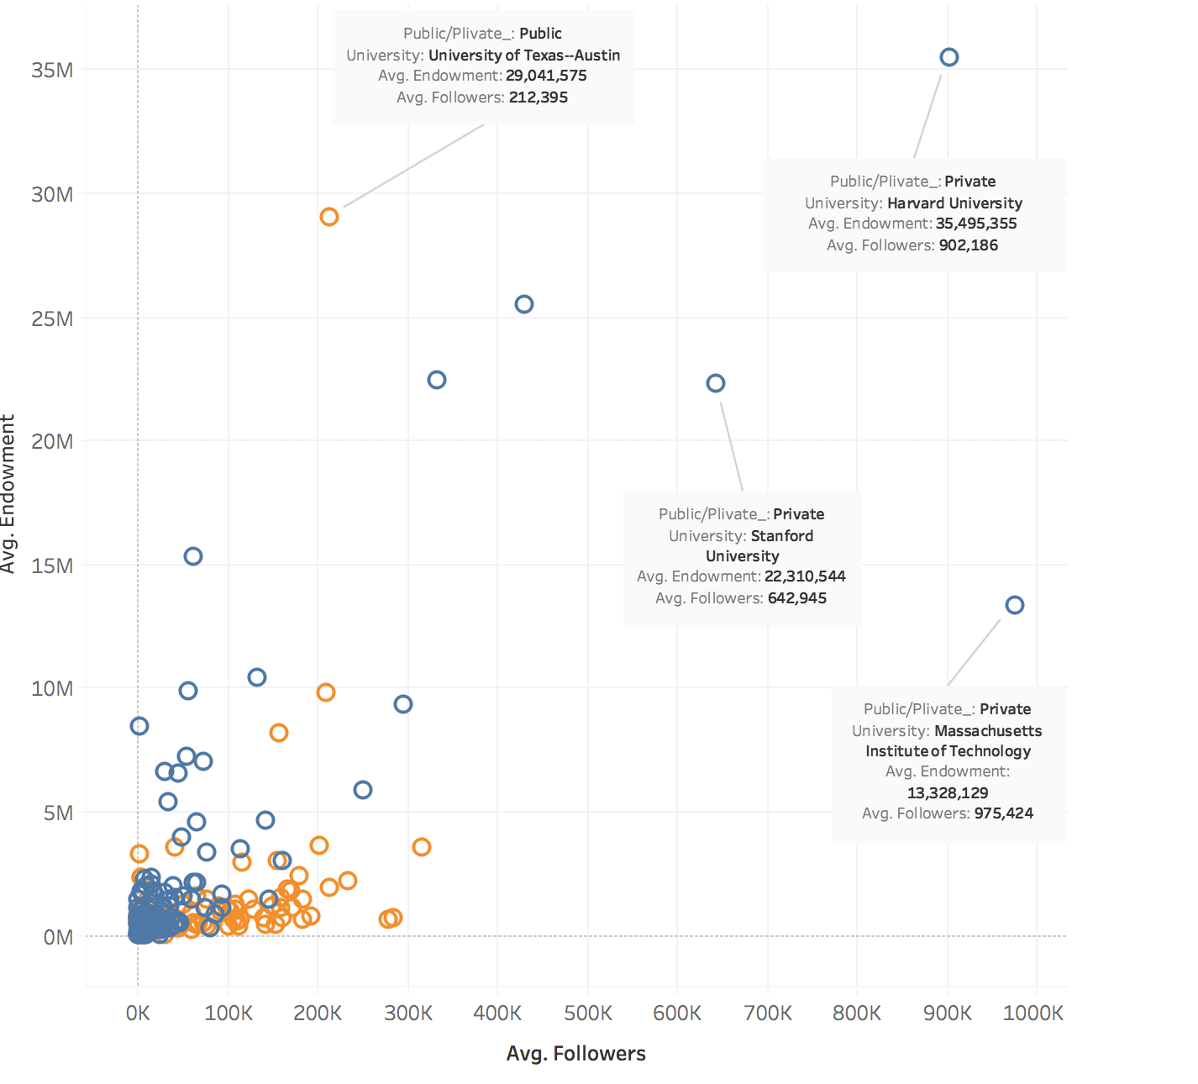
Visualizations - Endowments vs Twitter Followers
Endowments and twitter followers are not correlated
Endowments do not increase with regard to twitter followers

Slide 11
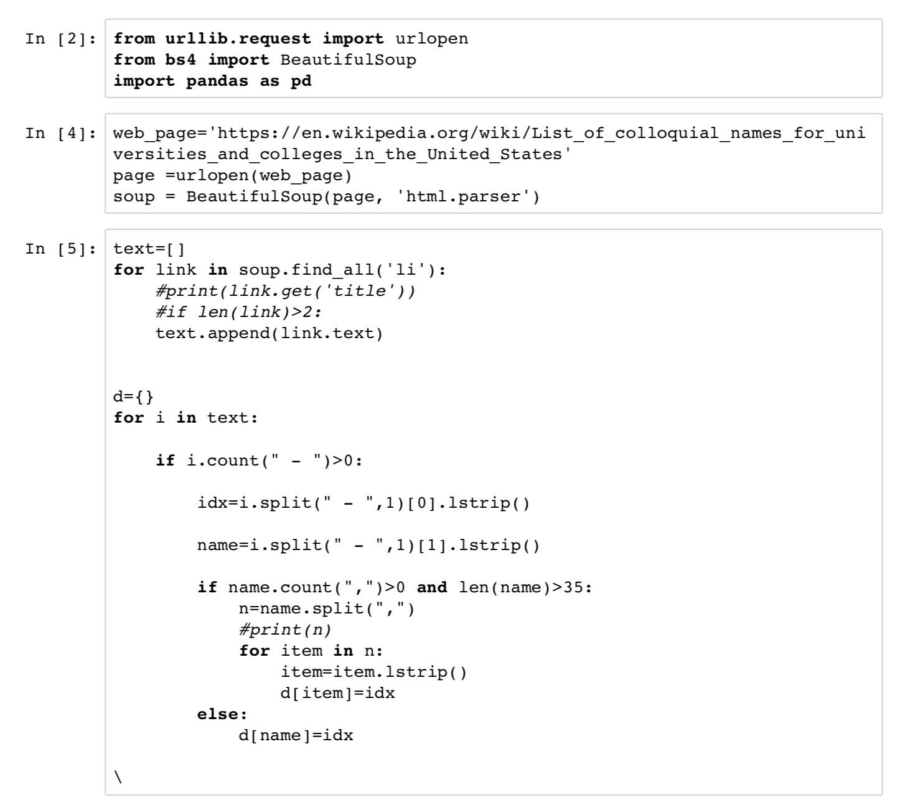
PCA analysis
Crawling data

Slide 12
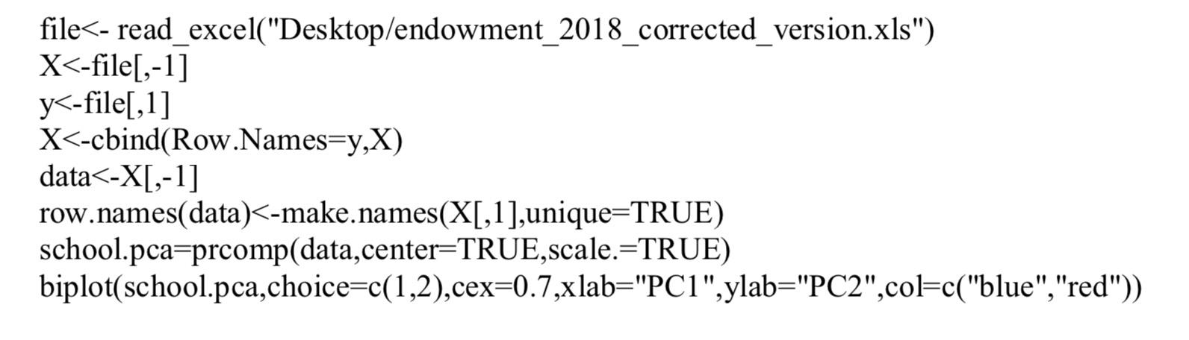
PCA analysis
Tri-plot using R

Slide 13
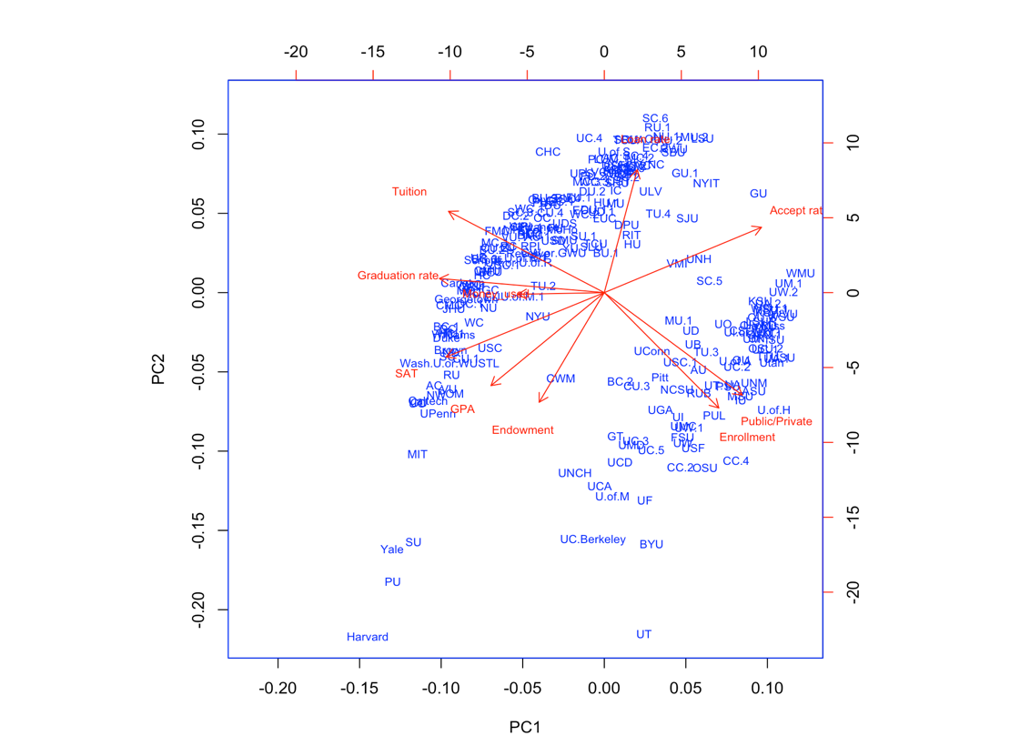
PCA analysis
Bi-plot

Slide 14
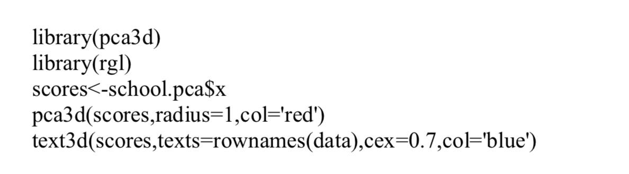
PCA analysis
Tri-plot using R

Slide 15
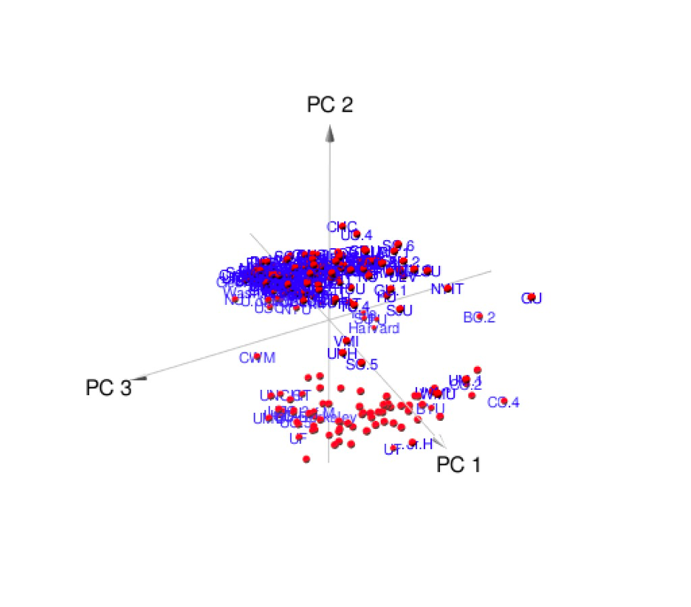
PCA analysis
Tri-plot

Slide 16
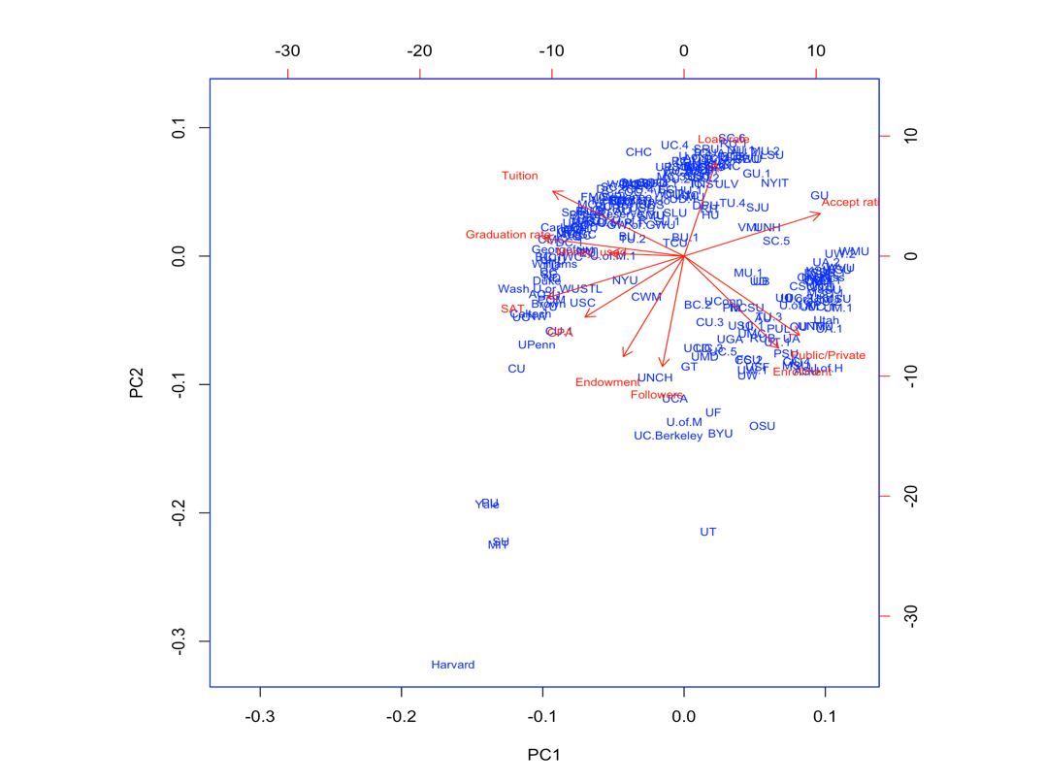
Twitter analytics
Bi-plot

Slide 17
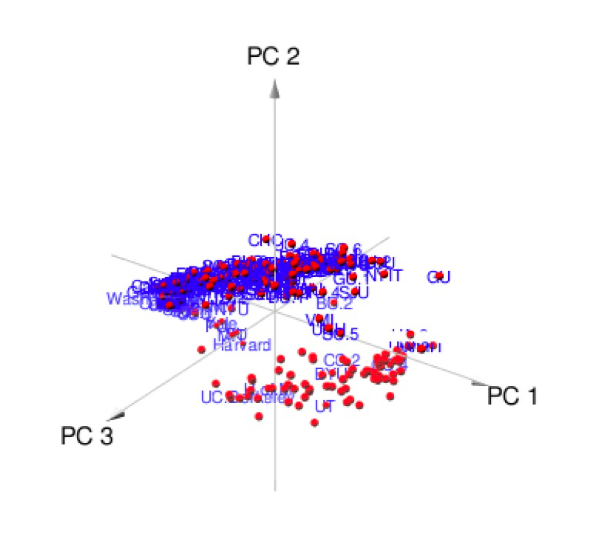
Twitter analytics
Tri-plot

Slide 18
Machine learning and Selective learning

Slide 19
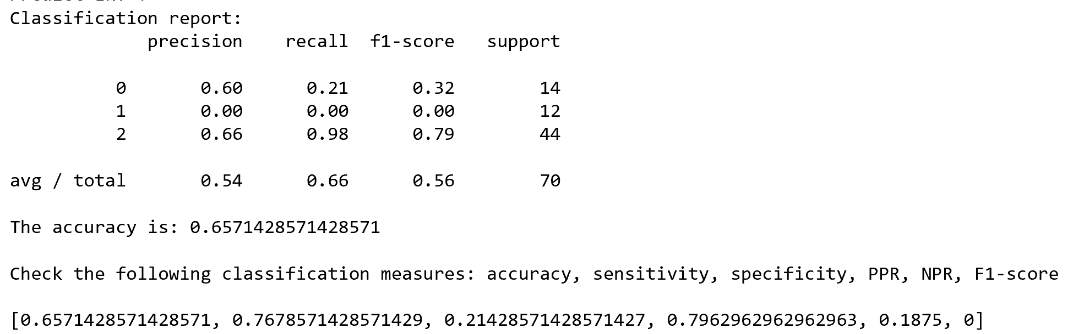
Extreme Random Tree

Slide 20
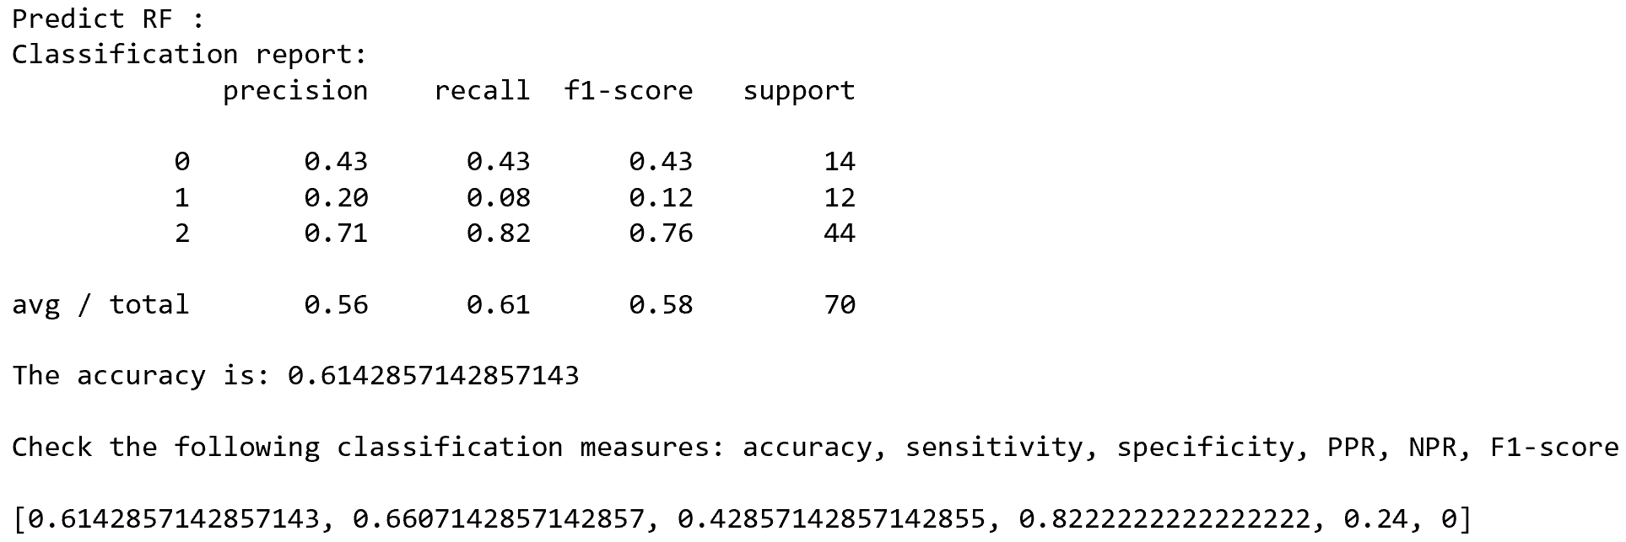
Random Forest

Slide 21
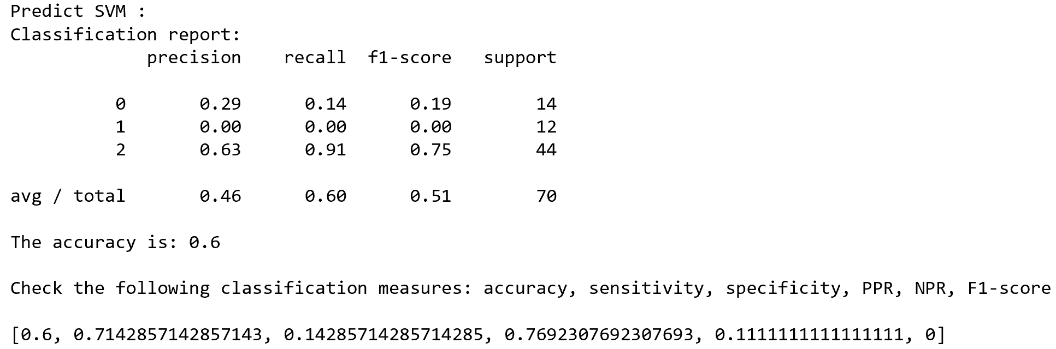
SVM (Support Vector Machine)

Slide 22
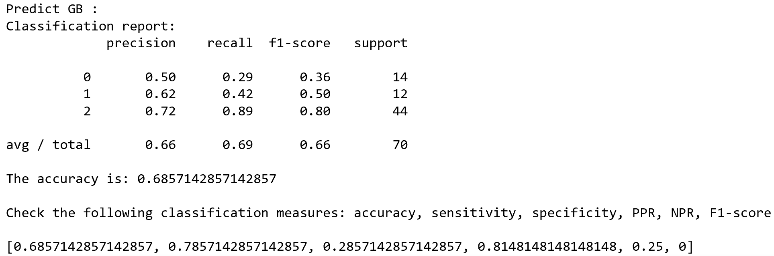
Gradient boosting

Slide 23
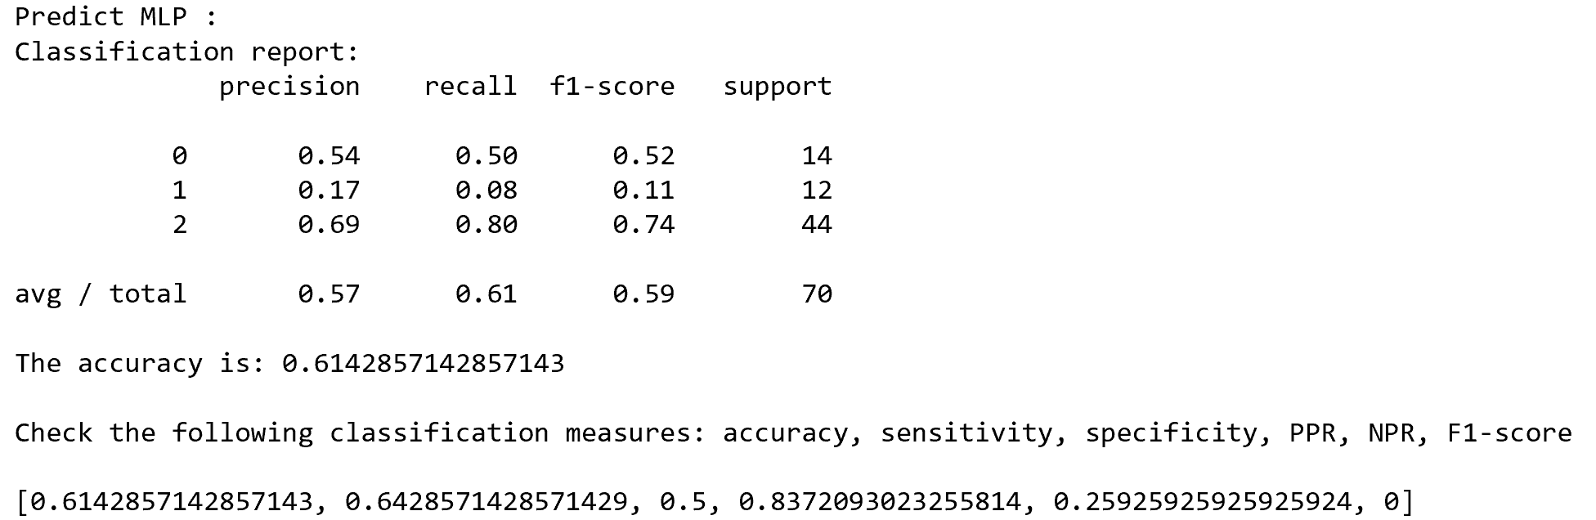
Deep neural networks (Multi-Layer Perceptron)

Slide 24
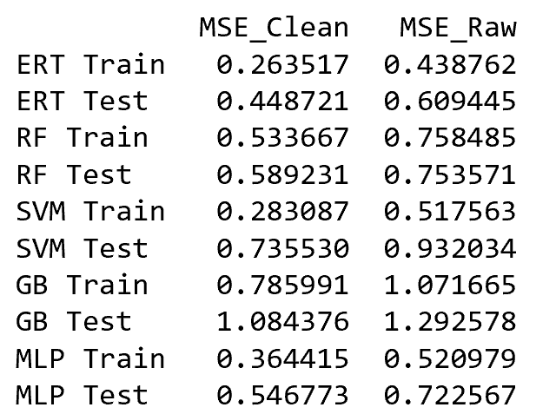
MSE score compare

Slide 25
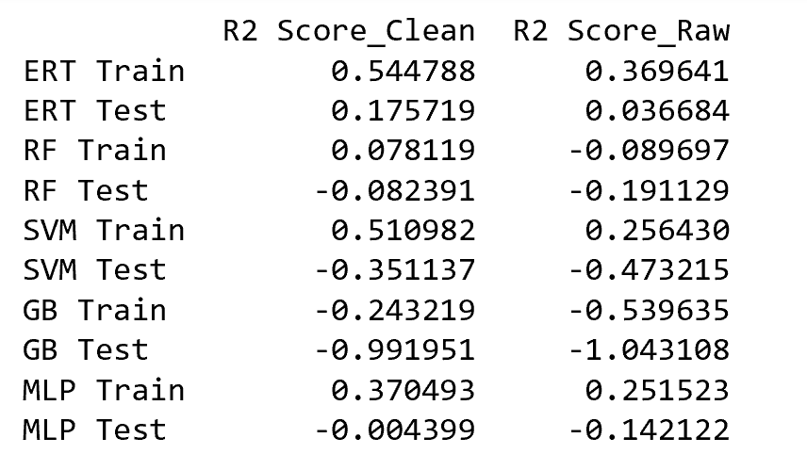
R^2 compare

Slide 26
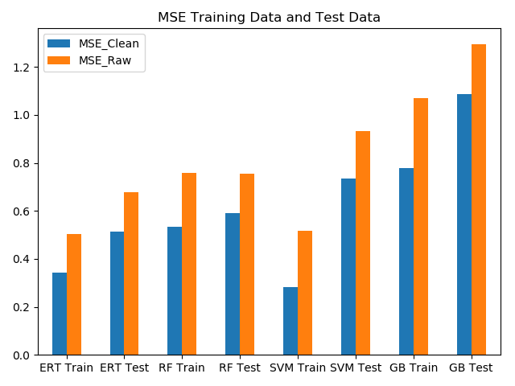
ERT and SVM Method have the lowest MSE- therefore, they would be the best methods to use for predicting how the money was used at each university

Slide 27
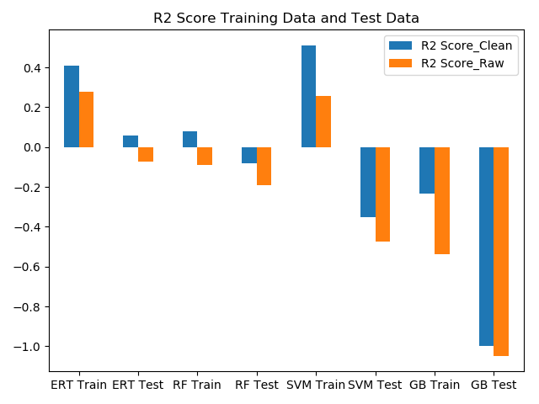
ERT and SVM Method have positive regression scores making them better regression models than the other methods.

Slide 28
Learning validation

Slide 29
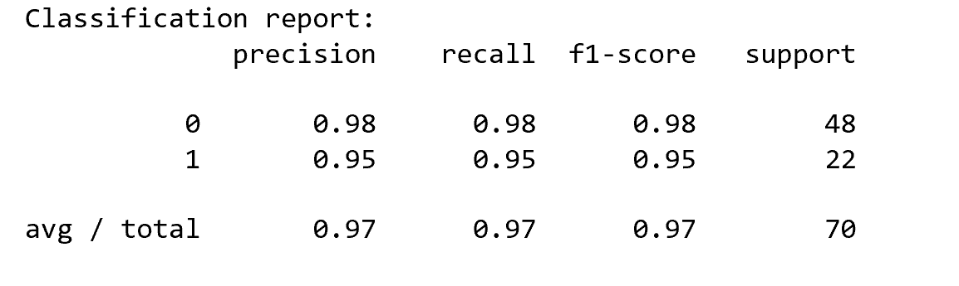
Extreme Random Tree

Slide 30
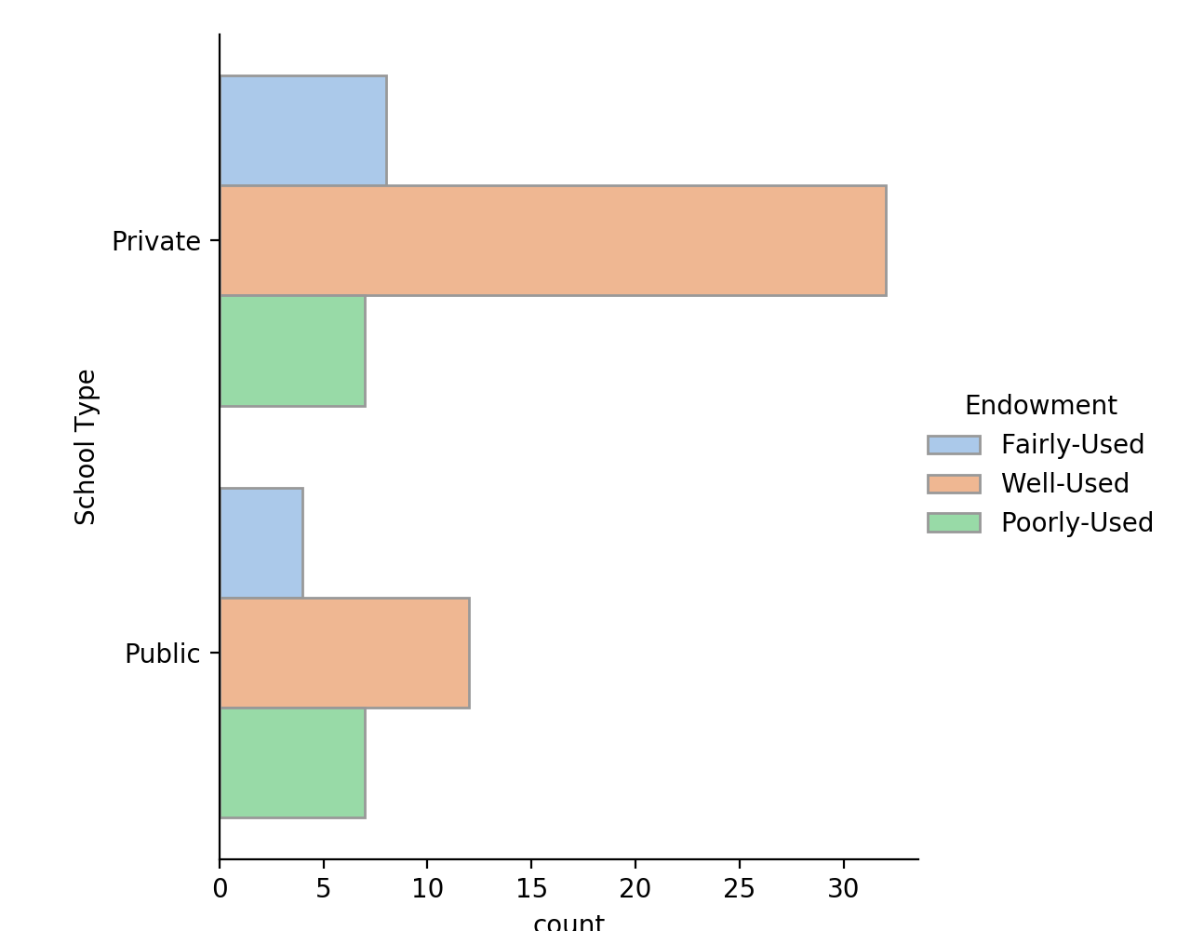
School Type v. Money used
Money seems to be predominantly well-used by both private and public schools, however, it is increasingly well-used in private schools compared to public schools

Slide 31
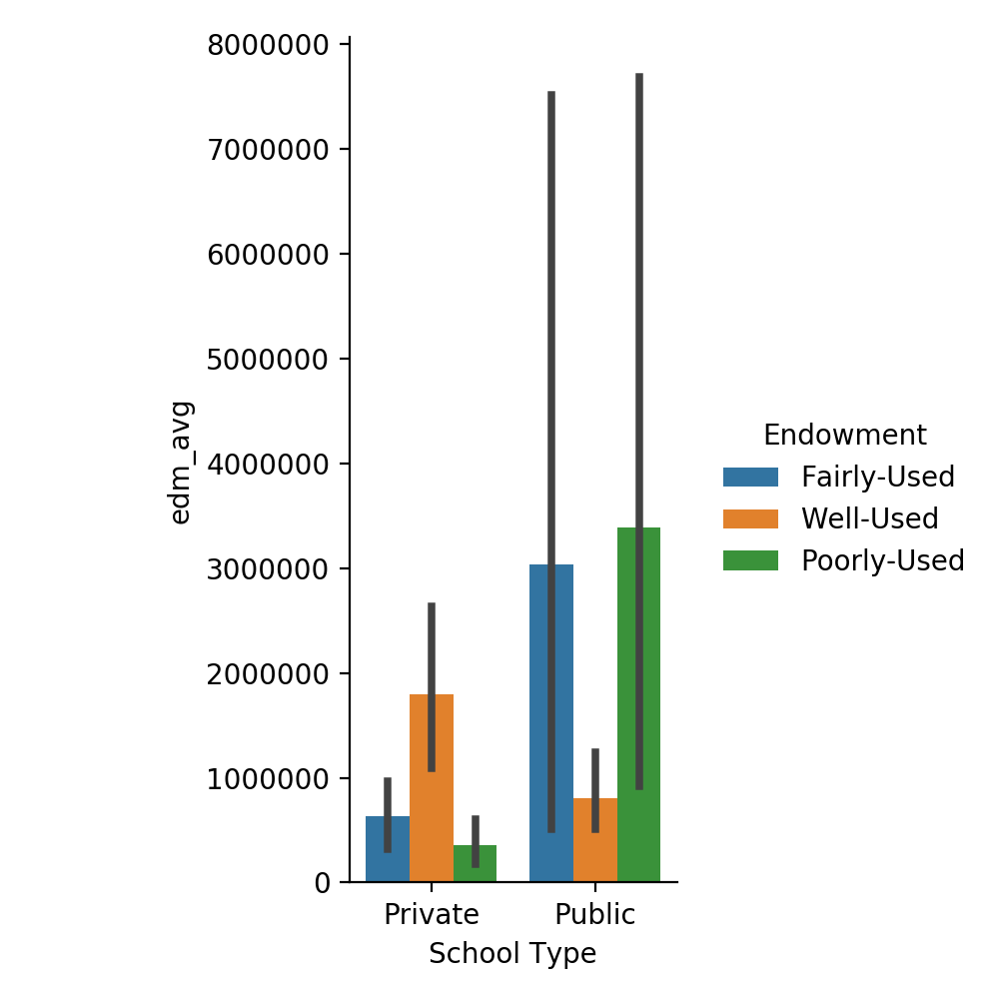
Endowment Average v. School Type
The endowment average among public schools is much higher in comparison to private schools, however, the endowment is better used amongst private schools in comparison to public schools

Slide 32
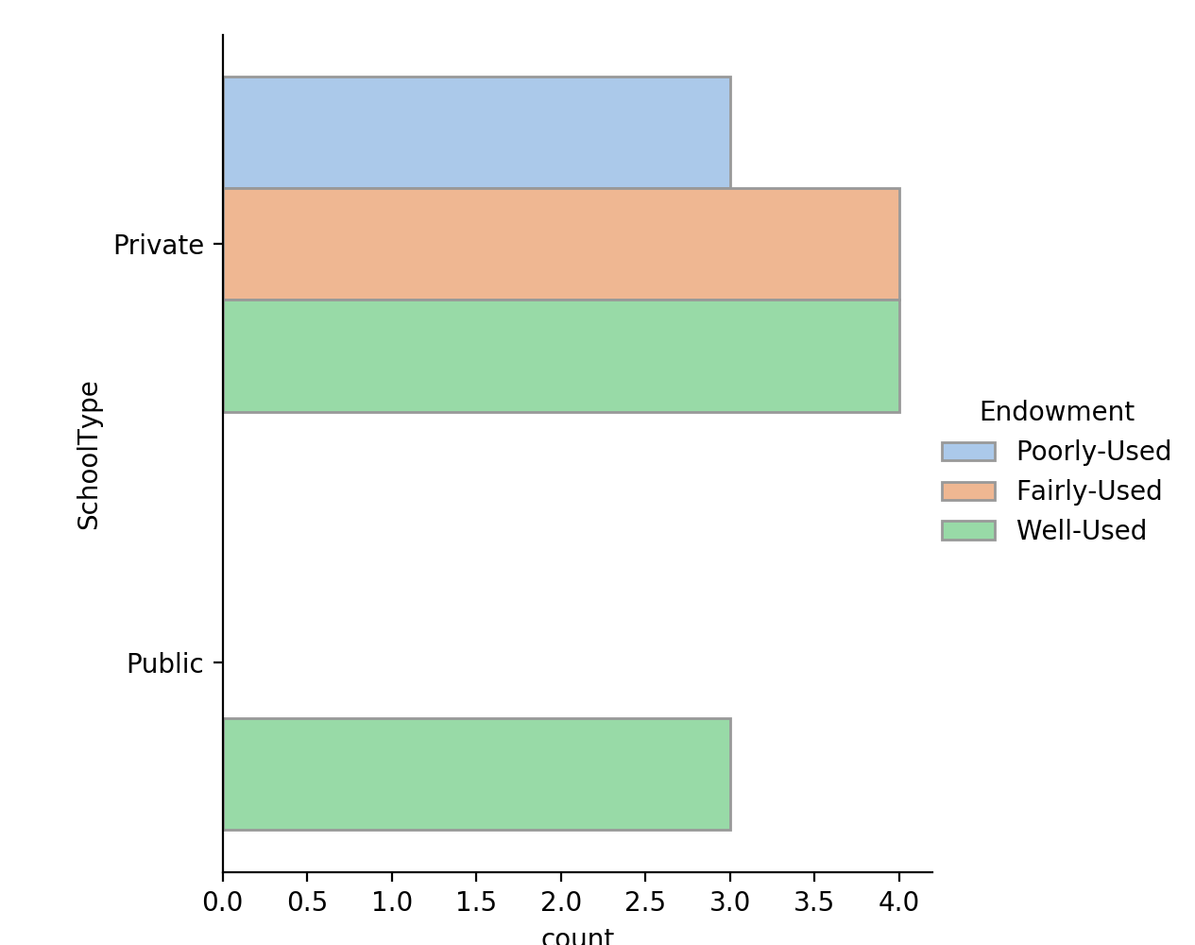
School Type v. Money used (Test Data)
In test data, we see that all of the endowment is well used for public schools whereas it is almost evenly spread amongst private schools

Slide 33
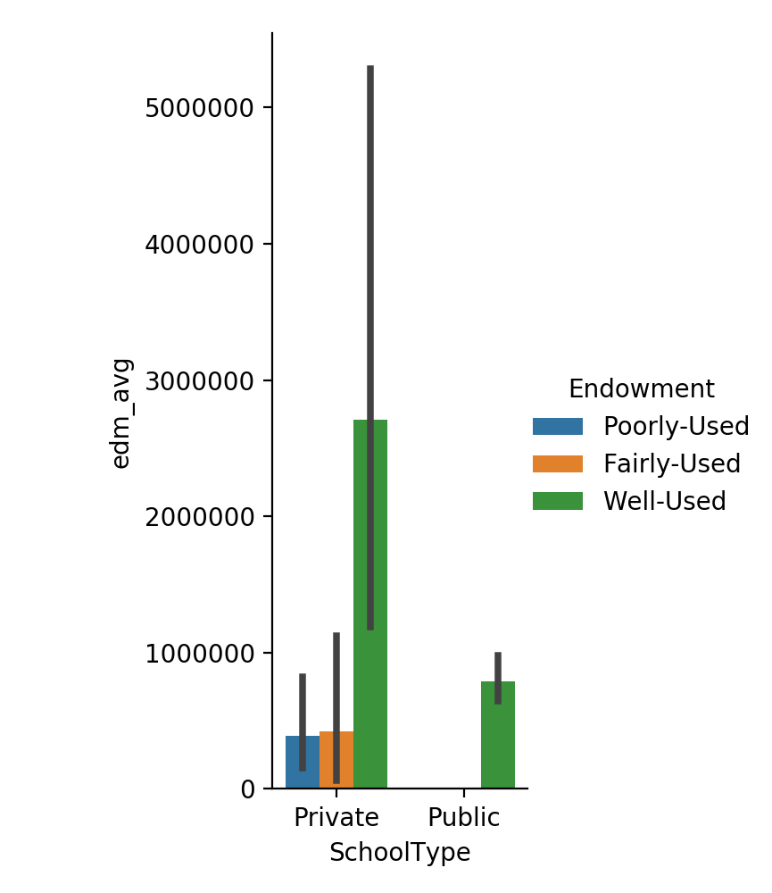
Endowment Average v. School Type (Test Data)
In the test data, endowment average is highest amongst private school but is also most well-used at private schools as well.

Slide 34
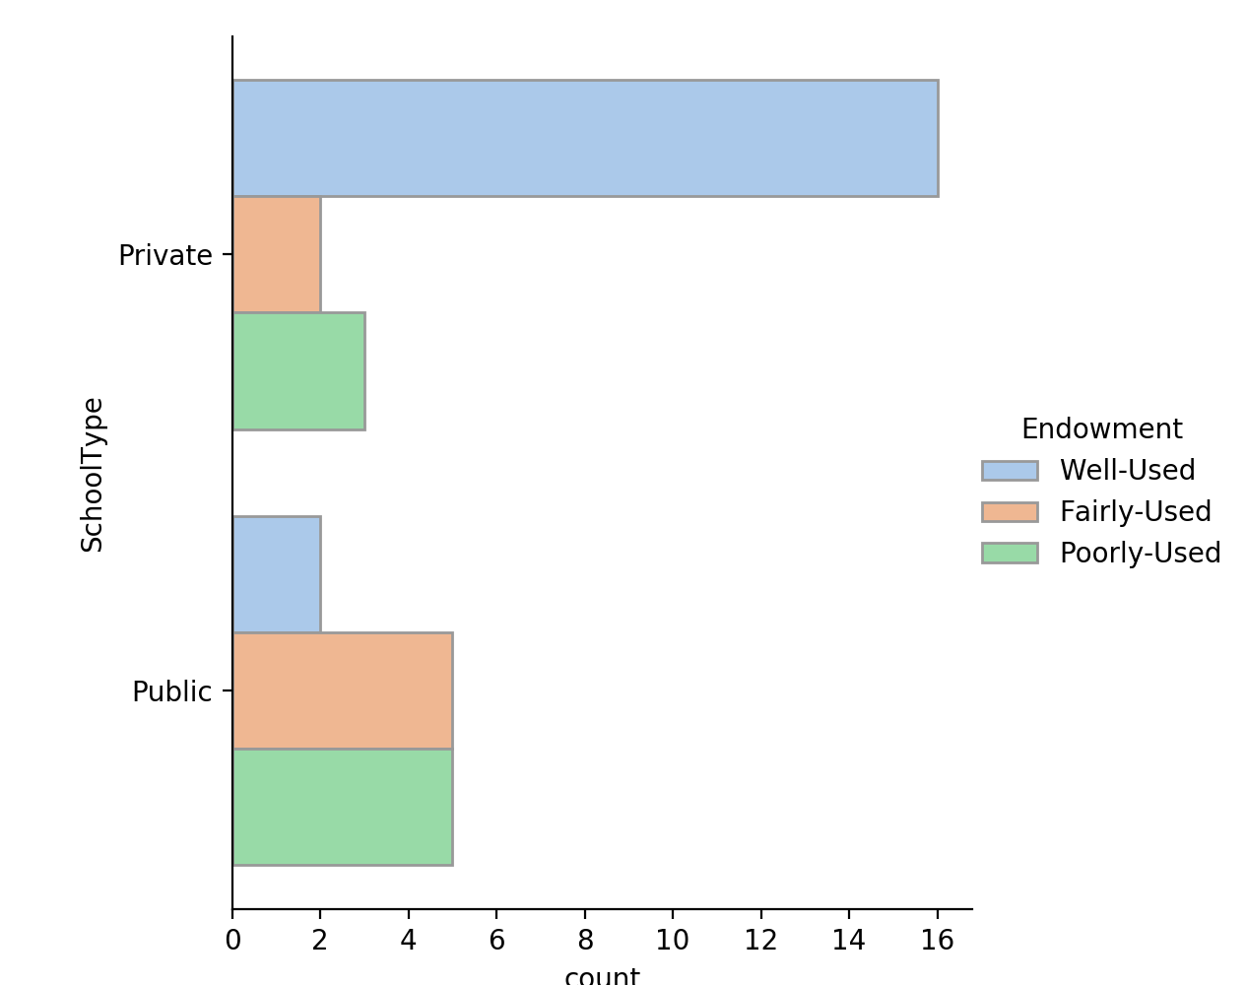
School Type v. Money used (Train Data)
In train data, again we see that endowment is most likely well used in private schools whereas, there is more likely of it being fairly or poorly used in public schools

Slide 35
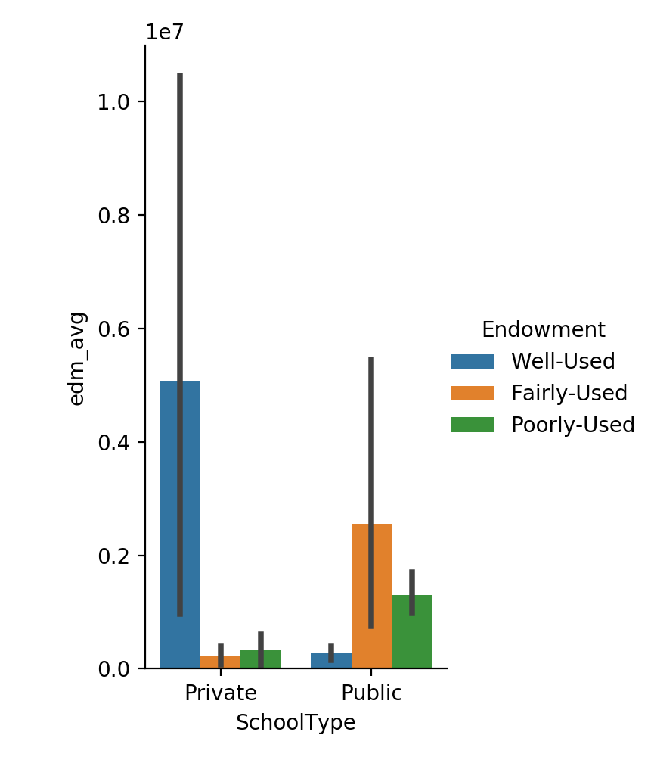
Endowment Average v. School Type (Train Data)
In train data, private schools receive the higher end of endowment averages, and they use it better than public schools as seen in the graph

Slide 36
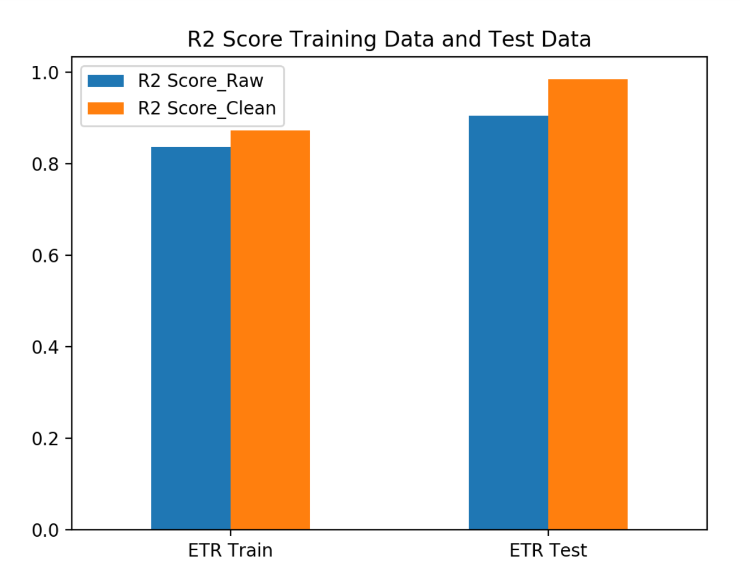

Slide 37
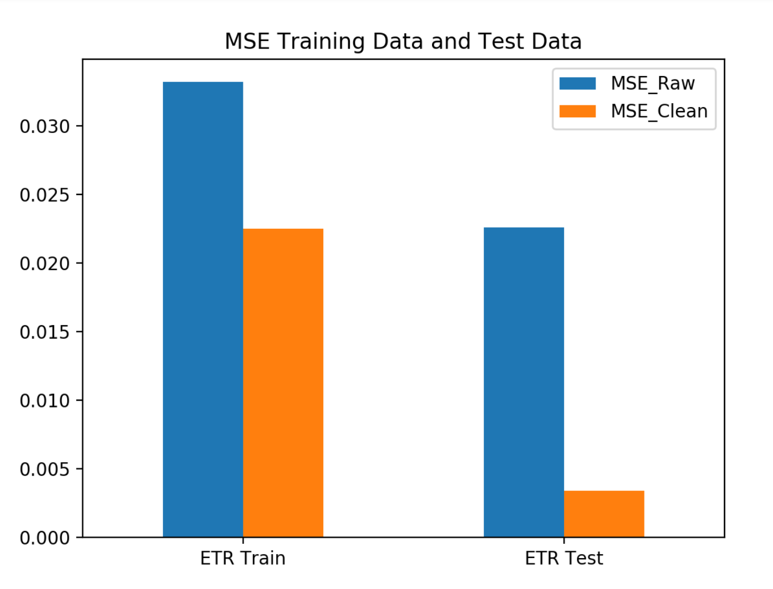

Slide 38
Learning Validation Conclusion
Private schools more likely to well use their money based on prediction. (significantly different than public)
Fair use and poor use money are relatively identical across both two types of schools.
After selective learning, the MSE for both train and test are decreased.
R^ 2 are increased meaning that the errors are less and the relevancy are increased.

Slide 39
Conclusion
Machine Learning power for predicting..
Different model performance.
Crawling data error.
Selective learning advantages.

Slide 40
Thank you

